Slide 1
CS 3186 Mathematical Preliminaries Section 1.1

Slide 2
Sets
A set is a collection of elements
A = {1,2,3}
B= {train, bus, bicycle, airplane}
We write
1 ∈ A 1 belongs to A
ship ∉ B ship does not belong to B

Slide 3
Set Representation
C = { a, b, c, d, e, f, g, h, i, j, k }
C = { a, b, …, k } finite set
S = { 2, 4, 6, … } infinite set
S = { j | j > 0, and j = 2k for some k>0 }
such that i.e., S={2,4,6,…}
S = { j | j is nonnegative and even }

Slide 4
Set Cardinality
For finite sets
A = { 2, 5, 7 }
|A| = 3
(set size)

Slide 5
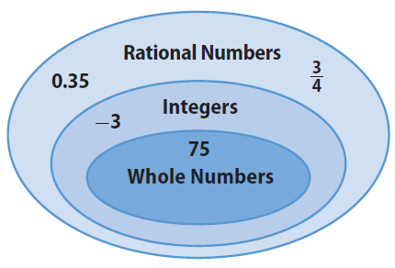
Venn Diagram
As is often the case in mathematics, a picture helps clarify a concept. For sets, we use a type of picture called a Venn diagram. It represents sets as regions enclosed by circular lines. For example:

Slide 6
PROOF TECHNIQUES
Proof by induction
Proof by contradiction
Proof by counter example
Proof by construction

Slide 7
Proof by Induction
Prove P₁, P₂, P₃, … P_{n} is true for all natural numbers n = 1,2,…
Base step (basis) – the first step
Prove that P₁ is true
Induction step
Assume P_{k} is true for all values 1 up to k
i.e., P₁, P₂, …, P_{k} are true
Prove that P_{k+1} is true.
We can Conclude that
Every P_{k} is true for all k =1, 2,…
Reason: Since P₁ is true (basis step), P₂ is true (induction step). Since P₂ is true, P₃ is true (induction step) and so on.

Slide 8
Proof by Contradiction
We want to prove that a statement P is true
we assume that P is false
then we arrive at an incorrect conclusion
therefore, statement P must be true

Slide 9
Proof by Counter-Example
By counter-example
Show an example that disproves the claim
Note: There is no such thing called a “proof by example”!
So when asked to prove a claim, an example that satisfied that claim is not a proof.
This is because it may not be true all the time.

Slide 10
Proof by Construction
By Construction:
One way to prove a theorem is to demonstrate how to construct the object.

Slide 11
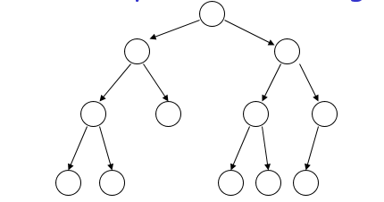
Proof by Induction - Example
Theorem: A binary tree of height n
has at most 2^{n} leaves.
Proof by induction:
let L(i) be the maximum number of
leaves of any subtree at height i

Slide 12
Proof by Induction – Example
We want to show: L(i) <= 2^{i}
Inductive basis
L(0) = 1 (the root node)
Inductive hypothesis
Let’s assume L(i) <= 2^{i} for all i = 0, 1, …, k
Induction step
we need to show that L(k + 1) <= 2^{k+1}

Slide 13
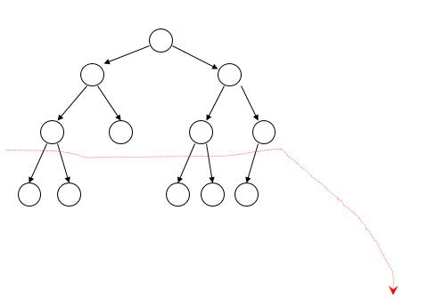
Proof by Induction - Example
Induction Step
Height
k
k+1
From Inductive hypothesis: L(k) <= 2^{k}

Slide 14
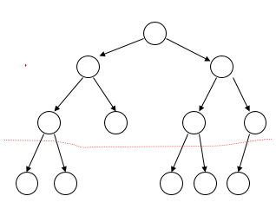
Proof by Induction – Example
Induction Step
Height
K
K+1
L(k) <= 2^{k}
L(k+1) <= 2 * L(k) <= 2 * 2^{k} = 2^{k+1}
(we add at most two nodes for every leaf of level k)

Slide 15
Example: Proof by Contradiction
Theorem: 2 is not rational
Proof:
Assume by contradiction that it is rational
√2 = n/m
n and m have no common factors
We will show that this is impossible
√

Slide 16
Example: Proof by Contradiction
= n/m ⇒ 2 m² = n²
√2
Therefore, n² is even ⇒ n is even
⇒ n = 2 k
2 m² = 4k² ⇒ m² = 2k² ⇒ m is even
⇒ m = 2 p
Thus, m and n have common factor 2
Contradiction!

Slide 17
I) Prove by Mathematical Induction: #36, #37, #38 II) Prove by Contradiction: #40, #41, #42, #43 III) Use counter example to show that: (i) for all positive integer n, n² − n + 3 is prime. (ii) for all positive integer n, n² − n + 41 is prime. (IV) Name all the proof techniques. Describe the procedure for any one of them clearly with any other example
Homework 1.1

